Slide 1
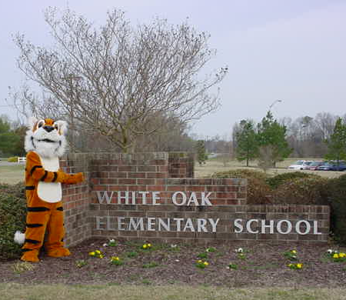
White Oak Elementary School
School Improvement Plan for 2010-2011

Slide 2
Ladies and Gentlemen!

Slide 3
School Improvement Team
Selected and voted on by members of grade level or department teams
Most members serve a three year term
Parents were nominated and voted on at the September 21, 2010, PTA meeting.

Slide 4
Assurances
Personal Planning
Horizontal Planning
Duty Free Lunch
Healthy Active Children
Reading by Grade 2

Slide 5
Student Learning Goals

Slide 6
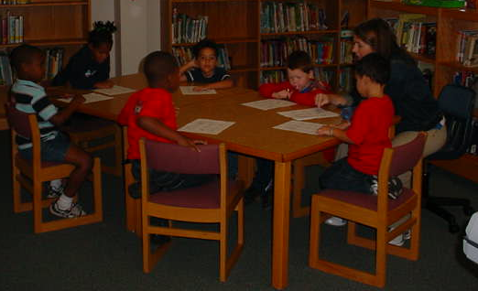
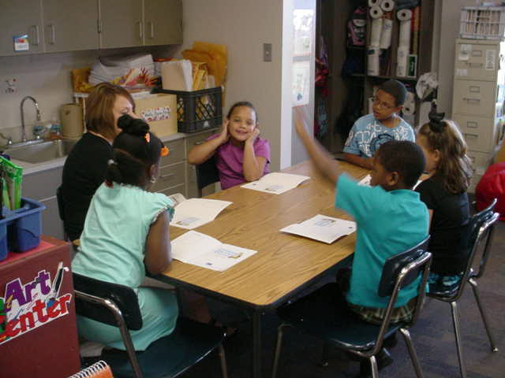
Goal 1: 75% of the students in kindergarten through second grade will be on grade level on math, reading, and writing end-of-year K-2 assessments.

Slide 7
Projects include:
-Procedures to ensure that children are getting their targeted interventions
-Provide differentiated math instruction
-Instructional Assistants and other selected staff members trained and implementing intervention programs and strategies

Slide 8
Projects Include:
-Establish SMART goals in the areas of Math, Reading and Writing
-Compare data with other schools
-Design and implement formative and summative math assessments (K-2)

Slide 9
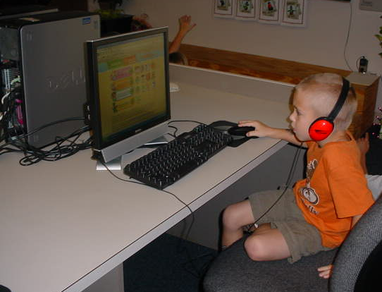
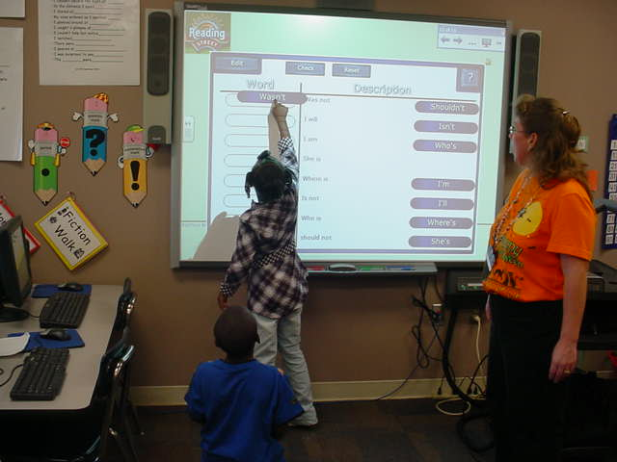
Goal 2: 100% of the students in pre-kindergarten through second grade will utilize 21st Century technology as documented in classroom plans, observations, computer lab logs, curriculum maps, and pacing guides.

Slide 10
Projects include:
-Conduct staff development to encourage more authentic uses of technology in the classroom
-Integrate technology into existing curriculum
-Develop a long range technology professional development plan

Slide 11
Organizational Effectiveness Goals

Slide 12
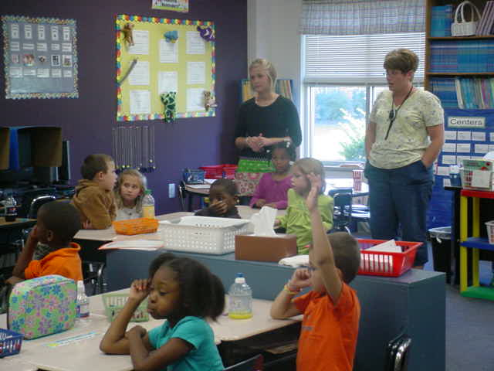
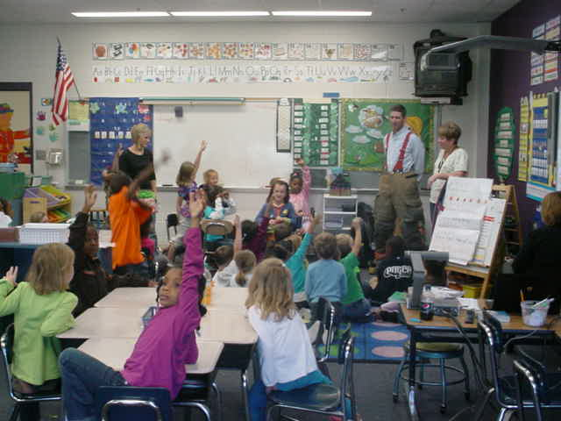
Goal 1: 90% of faculty and staff will engage in meaningful and regular communication and collaboration as measured by the annual Community Building Survey.

Slide 13
Projects include:
-Pursue vertical articulation among transitional grade levels (2nd-3rd)
-Develop a long range plan to implement vertical alignment

Slide 14
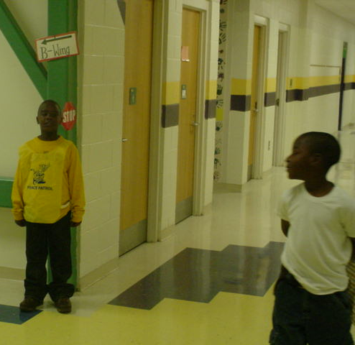
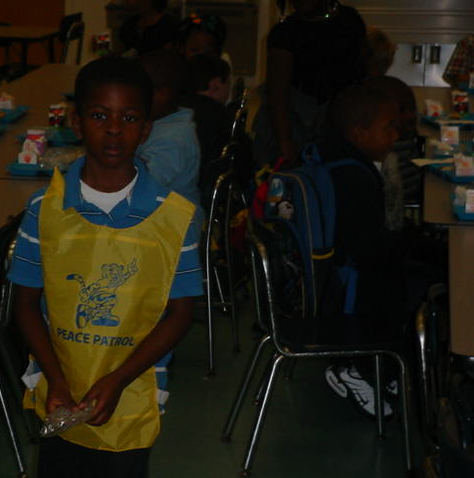
Goal 2: 90% of faculty and staff will feel that discipline problems are handled consistently and in a timely manner as measured by the annual School Safety Survey.

Slide 15
Multi-year PBIS Comparison Data

Slide 16
Projects include:
-Behavior component of RtI/PBIS
-Formal behavior intervention plans
-Revamp the Cubbie Peace Patrol

Slide 17
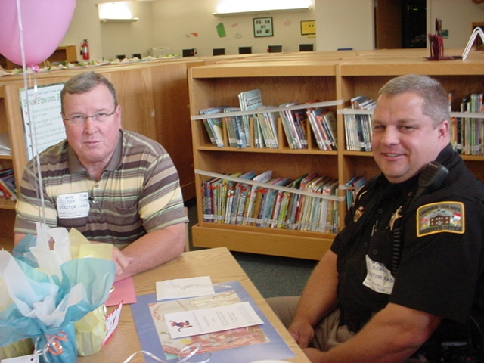
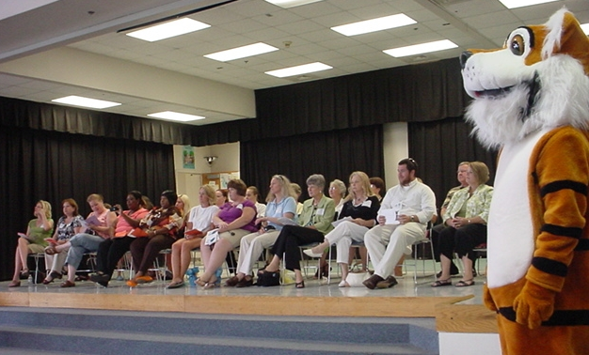
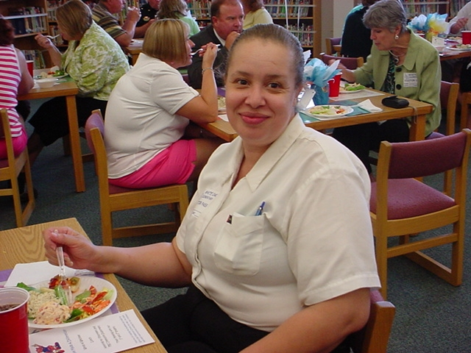
Goal 3: 85% of parents will become actively involved in one or more school activities each year as evidenced by sign-in logs.

Slide 18
Projects include:
-Use volunteers effectively
-Increase PTA membership and parent involvement
-Implement sneak peek night
-Investigate providing transportation to parent programs

Slide 19
2010-2011 Community Supporters
Chowan Hospital - Stake It!
McDonald’s - Bus incentives for Bus of the Month
Subway- attendance incentives
Pizza Hut - Book It!
Food Lion- Supports Positive Office Referrals
Churches- school donations and monetary donations for family assistance needs

Slide 20
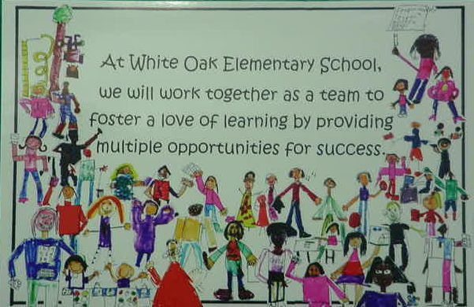
Living the Plan

Slide 21
“This Day of Peace”

