Slide 1
Superintendent’s Report
August 2023

Slide 2
Convocation - August 23rd @ 9:15am Rocky Hock Baptist

Slide 3
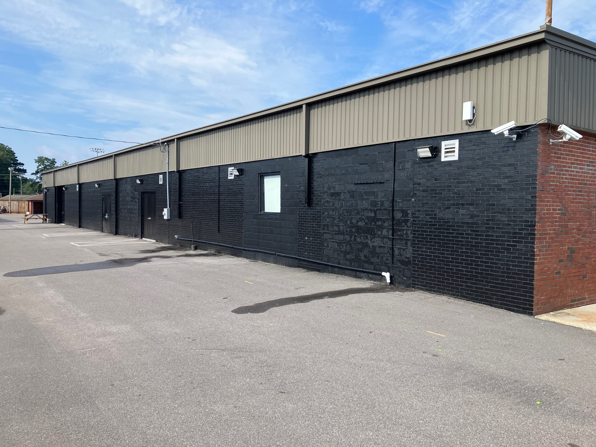
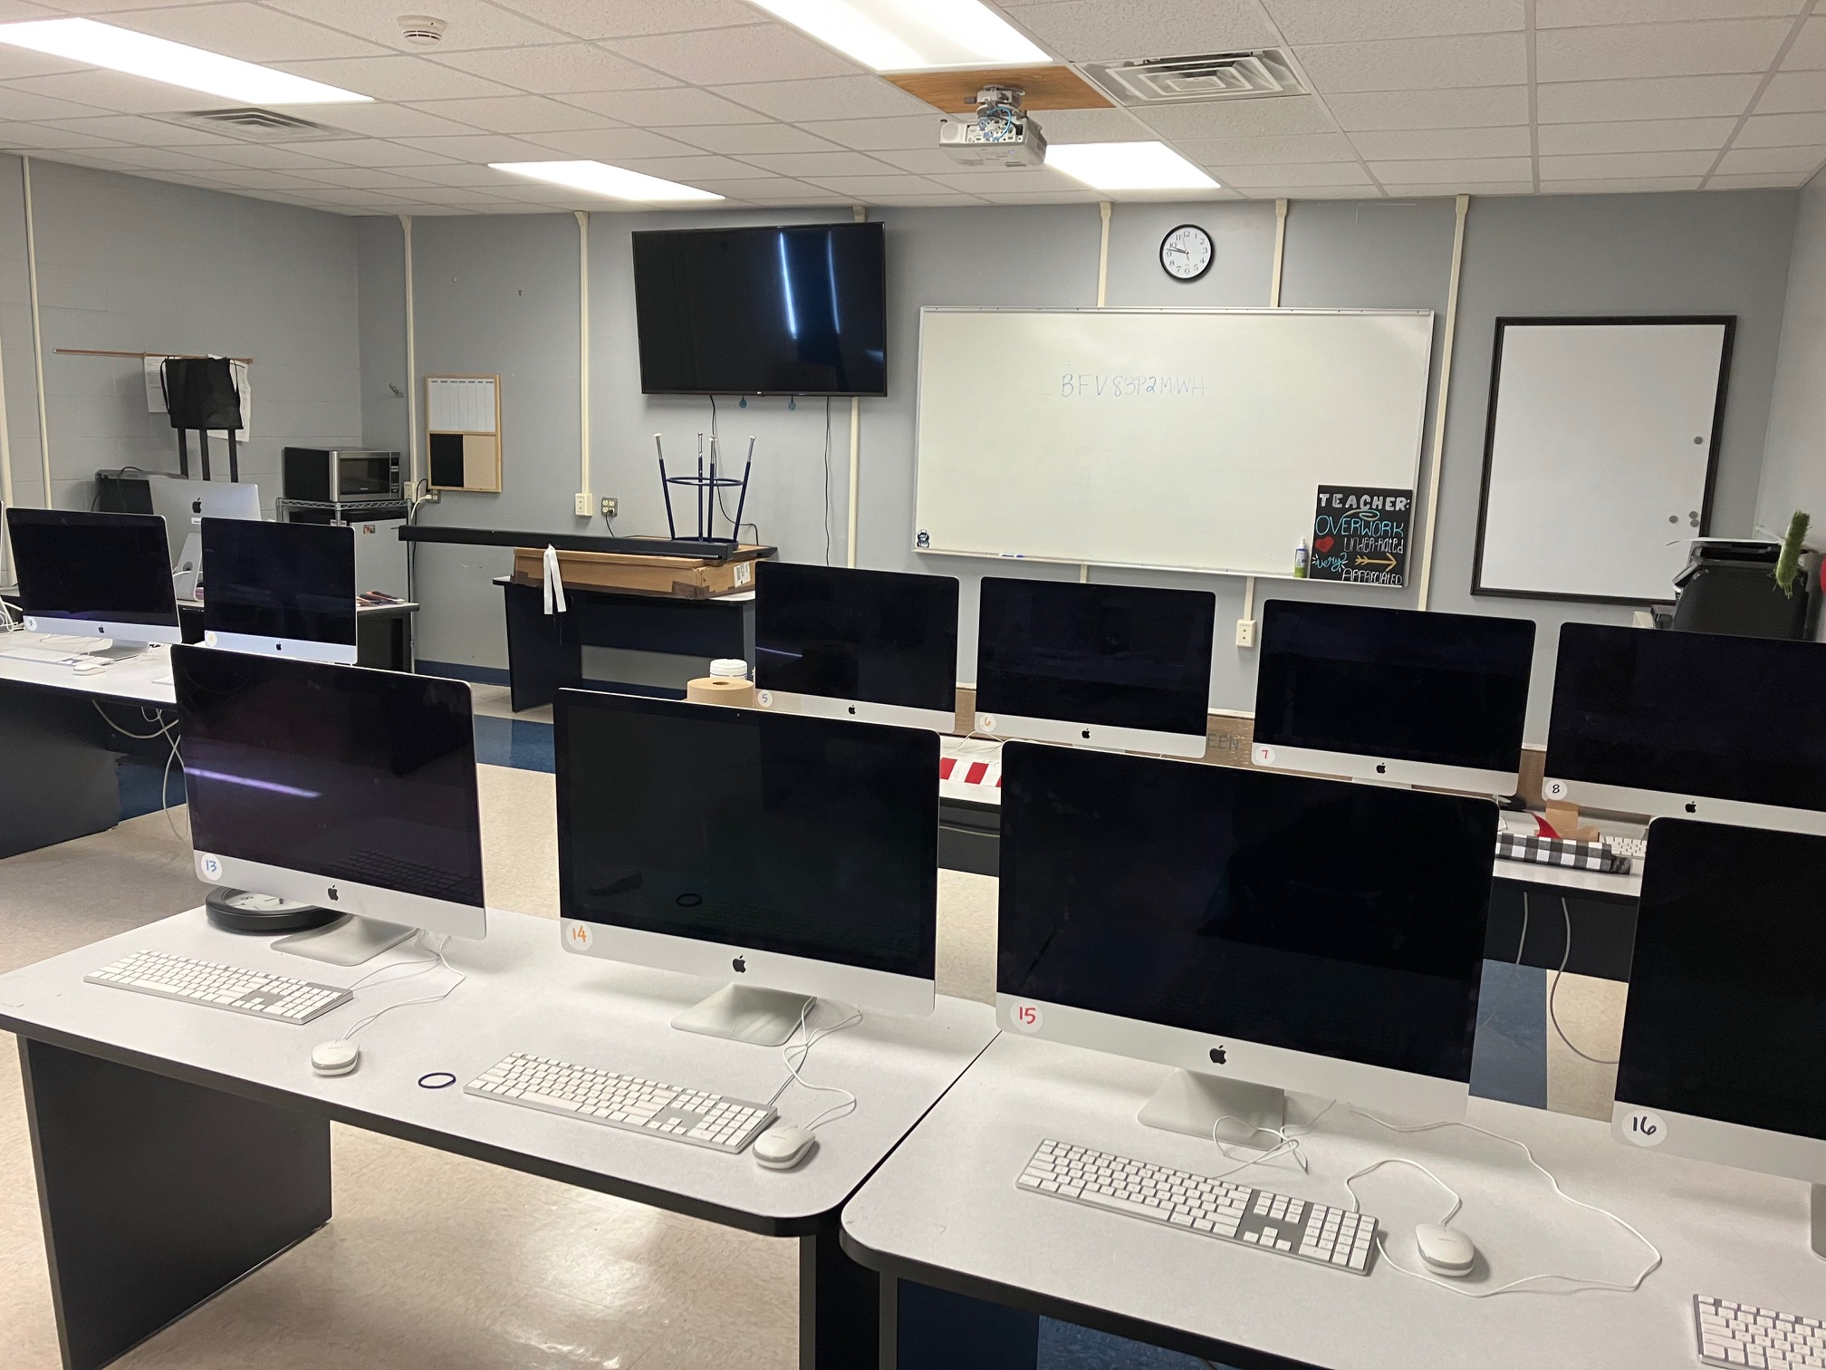
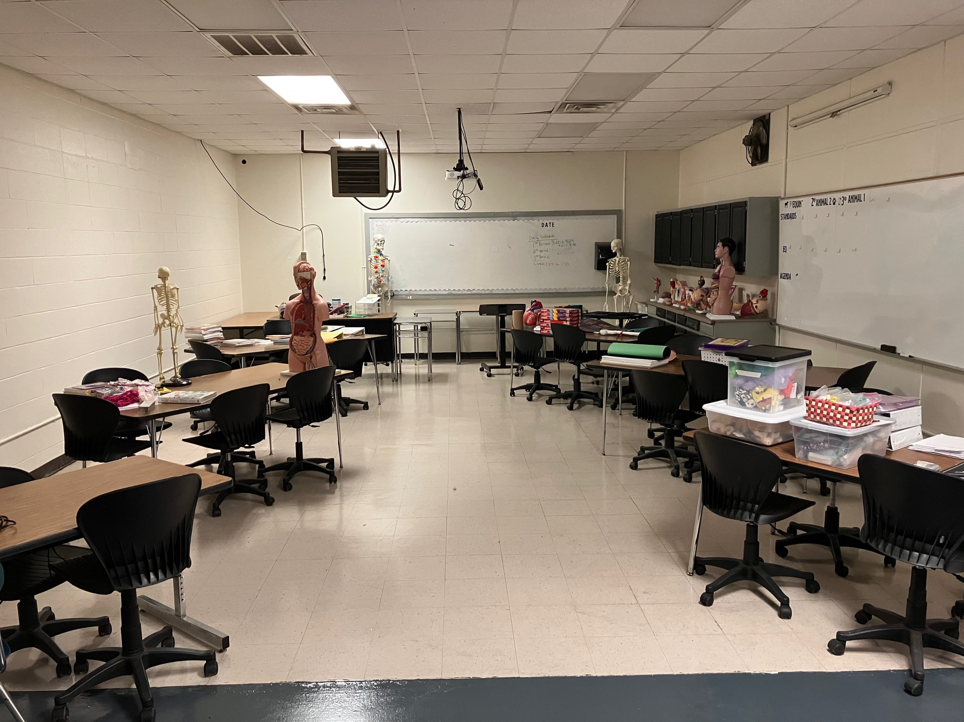
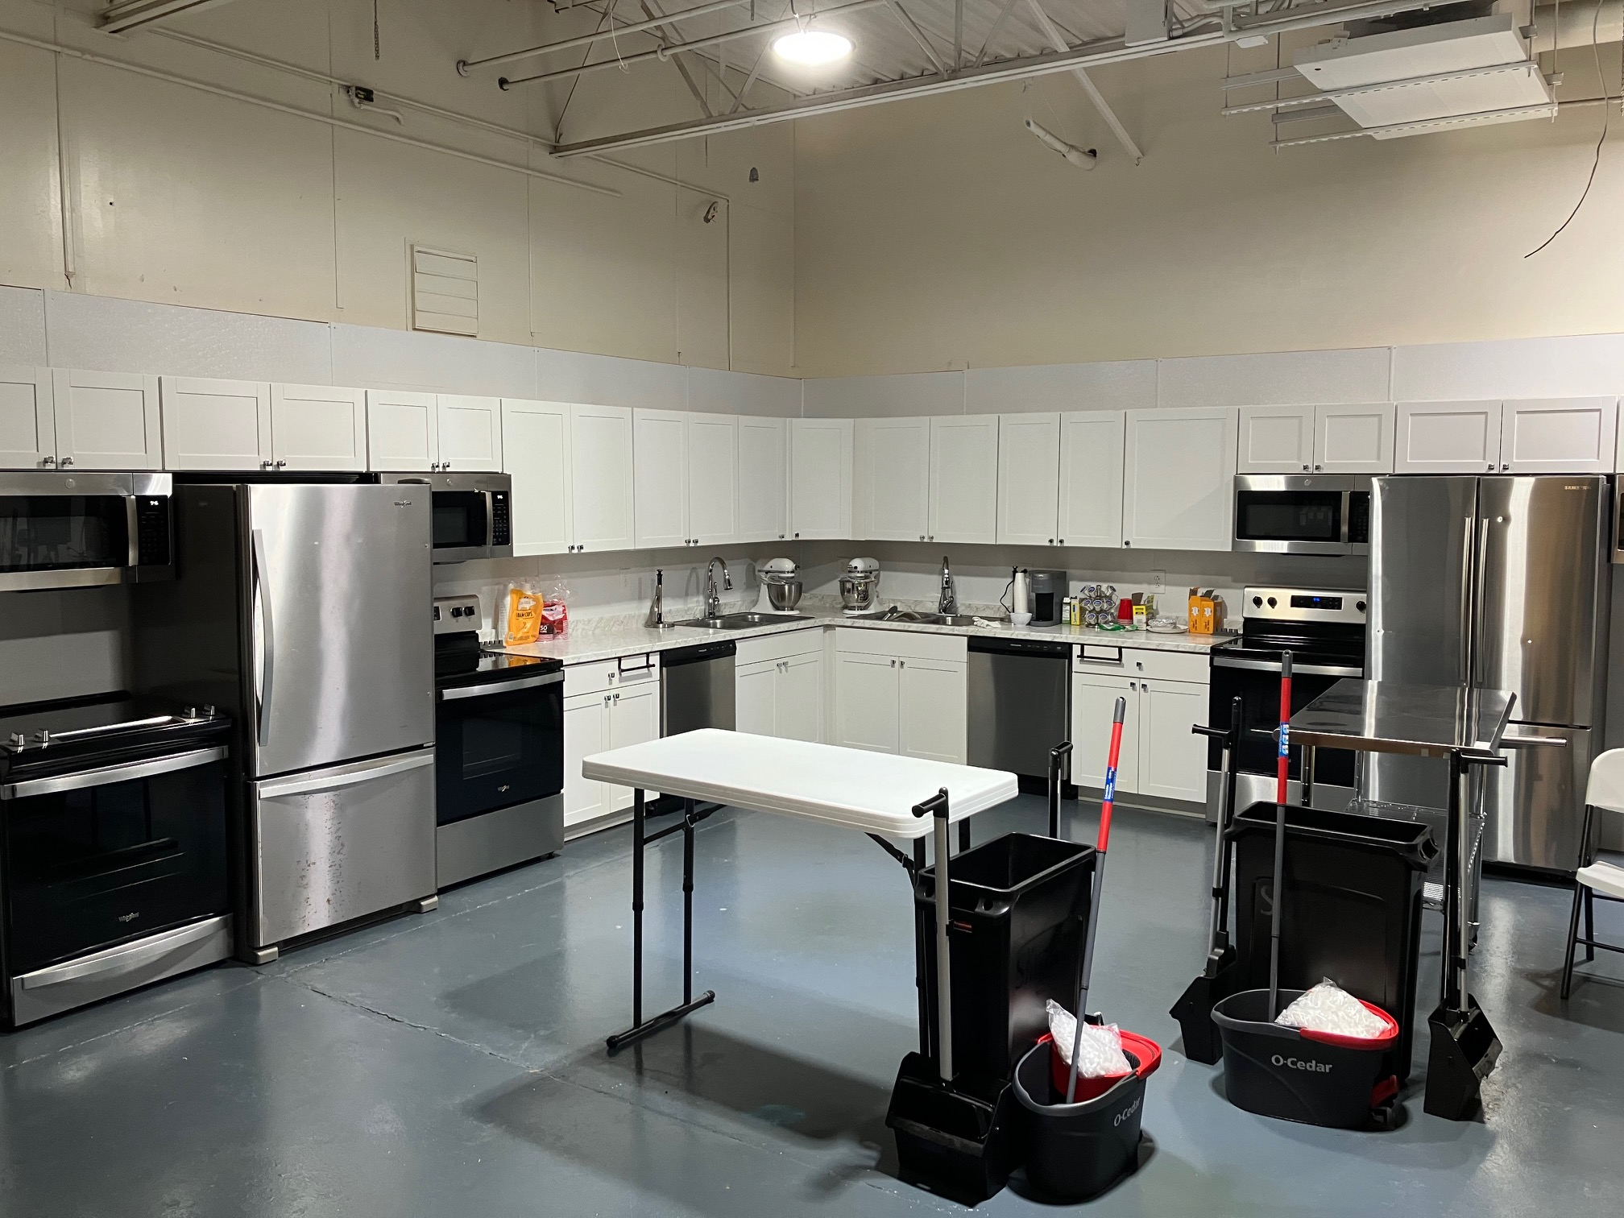
New CTE Learning Spaces

Slide 4
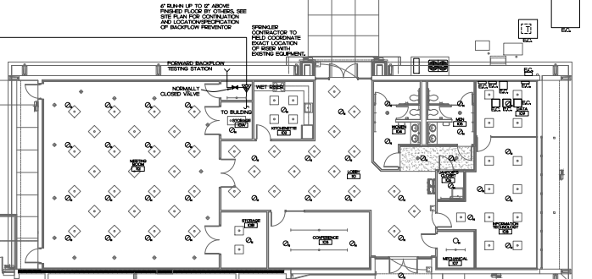
Technology Facility Public Bid Opening - August 16th

Slide 5
Vacancy Update
White Oak | 2 Classroom Teachers
Chowan Middle | 7th Grade Math Teacher Music Teacher
John A. Holmes | Band Teacher Spanish Teacher
DFW, CMS, JAHHS | Art Teacher

