Slide 1


Slide 2

What is GEAR UP?
Gaining Early Awareness and Readiness for Undergraduate Programs (GEAR UP)
Established in 1998 and funded through the US Department of Education
Work with cohorts of students, starting no later than 7th grade, in middle schools with 50% or more free and reduced lunch
Goals
  Increase academic performance and preparation for postsecondary education
  Increase the rate of high school graduation and participation in postsecondary education
  Increase GEAR UP students’ and their families’ knowledge of post secondary education options, preparation, and financing

Slide 3

GEAR UP North Carolina - History
2000
  First state grant awarded, 2000-2006
  15 school districts
  Approximately 8000 students, unduplicated
  $7,525,007 federal funding
  $7,726,401 local support
  Referred to as “Cohort I”
2005
  Second state grant, 2005-2011
  19 school districts
  Approximately 15,627 students
  $19, 267,721 federal support over the six-year grant
  Equal match from state and local support
  Referred to as “Cohort II”
Notes:
Cohort approach – all students in the 7th grade eligible to participate. Some services may be targeted, for example – students not passing EOG, students with interest in science. The students with the greatest need should be the students who are most strongly encouraged to participate

Slide 4
GEAR UP North Carolina - Current
2012
- Third state grant, 2012-2019
- 11 school districts; 46 middle and high schools
- Approximately 22,000 students
- $28.6 million federal support over the seven-year grant
- Equal match from state and local support
- Referred to as “Cohort III”
Building on success of Cohort II
- GEAR UP North Carolina high schools experienced a 10.3 percentage point increase in the percentage of students graduating from high school during the six year program
- Outpaced the state in improving high school graduation rates; narrowing the gap between GEAR UP high schools and the state by almost half
- College enrollment rates increased by almost 10 percentage points across GEAR UP NC, growing from 52.4% to 62.2%
Notes:
Not only was the pool of students eligible for postsecondary education increased, but even in doing that, we still increased postsecondary enrollment rates.

Slide 5
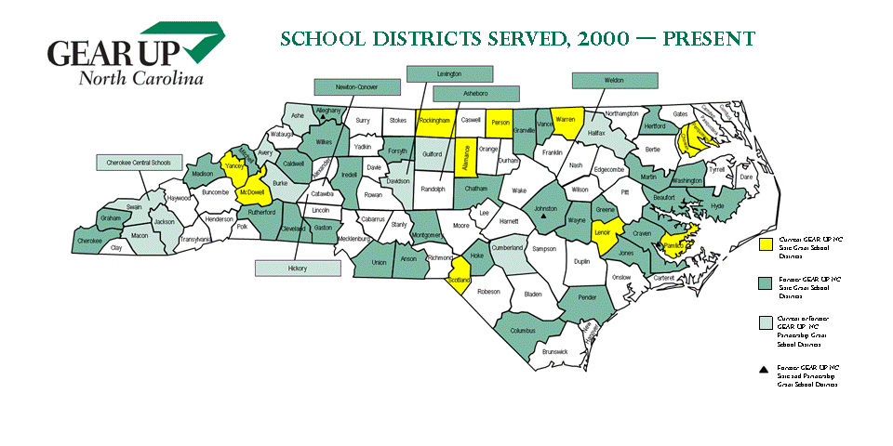

Slide 6
GEAR UP Grant III Cohort and Priority Model
Cohort Model will serve 4 Cohorts of 7th grade students and their families throughout the seven-year project.
Priority Model will serve all 12th graders and their families at target high schools years 01-05 and in year 02 will begin serving first-year college students.
Whole-school approach where every student in qualifying grades will be served.
 | Year 01 | Year 02 | Year 03 | Year 04 | Year 05 | Year 06 | Year 07
7th Grade | Cohort 1 | Cohort 2 | Cohort 3 | Cohort 4
8th Grade |  | Cohort 1 | Cohort 2 | Cohort 3 | Cohort 4
9th Grade |  |  | Cohort 1 | Cohort 2 | Cohort 3 | Cohort 4
10th Grade |  |  |  | Cohort 1 | Cohort 2 | Cohort 3 | Cohort 4
11th Grade |  |  |  |  | Cohort 1 | Cohort 2 | Cohort 3
12th grade | Priority 1 | Priority 2 | Priority 3 | Priority 4 | Priority 5 | Cohort 1 | Cohort 2
1st Year College |  | Priority 1 | Priority2 | Priority 3 | Priority 4 | Priority 5 | Cohort 1

Slide 7
Specific GEAR UP NC Goals
Goal 1.1
Increase the percentage of students taking and successfully completing Pre-Algebra by the end of 8th grade.
Goal 1.2
Increase the percentage of students taking and successfully completing Algebra I by the end of 9th grade.
Goal 1.3
Increase the percentage of students taking and successfully completing two years of math beyond Algebra I by the end of the 12th grade.
Goal 1.4
Increase the percentage of students who have knowledge of and demonstrate necessary academic preparation for college.
Goal 1.5
Increase the percentage of students who enroll in college without the need for remedial coursework.

Slide 8
Specific GEAR UP NC Goals
Goal 2.1
Decrease the high school dropout rate.
Goal 2.2
Increase the high school graduation rate.
Goal 2.3
Increase average daily attendance rates at middle schools and high schools.
Goal 2.4
Increase the percentage of students who apply, enroll, and succeed in college.
Goal 2.5
Increase the percentage of students who are on track to graduate from college.

Slide 9
Specific GEAR UP NC Goals
Goal 3.1
Increase students’ and families’ knowledge of postsecondary education financing.
Goal 3.2
Increase families’ active engagement in assisting students with academic preparation for college.

Slide 10
Local GEAR UP Staff
District will hire a GEAR UP Coordinator
  100% of time dedicated to GEAR UP
  12-month LEA employee
  Will report to LEA central office administrator (GEAR UP Liaison)
  Provide services to students at target schools, collaborate with school staff, and enter monthly service data (at a minimum)
  Minimum qualifications will include:
    Experience working with youth
    Knowledge of college planning, admissions requirements, and financial aid resources
    Demonstrated commitment to college access
    Minimum of a Bachelor’s Degree

Slide 11
Local GEAR UP Staff
District will hire a Family and Community Facilitator
  100% of time dedicated to GEAR UP
  12-month LEA employee
  Will report to LEA central office administrator (GEAR UP Liaison)
  Will provide services to the families of students at target schools, enter monthly service data, and engage local organizations, businesses, and colleges and universities in GEAR UP programming to ensure sustainability post-federal funding
  Minimum qualifications will include:
    Prior experience in community collaboration
    Knowledge of college planning, admissions requirements, and financial aid resources
    Minimum of a Bachelor’s Degree

Slide 12
Local GEAR UP Steering Committee
District will establish a GEAR UP Steering Committee
  Committee will serve to guide and refine the college access framework within the district
  Must meet no less than quarterly to discuss progress, challenges, and next steps
  Committee should be comprised of:
    GEAR UP Coordinator
    GEAR UP Family and Community Facilitator
    GEAR UP Liaison
    School staff such as: counselors or teachers
    Students
    Families
    Local organizations, businesses, and colleges
    Represent the larger community in terms of race,
    ethnicity, and gender

Slide 13
Local GEAR UP Framework
District will create a College Access Framework in Year 01 that will outline how the district will:
  Incorporate use of data, academic rigor and support, family engagement, community support, and high expectations for ALL GEAR UP students to meet the goals of the statewide program
  Framework will identify resources already in place and gaps where resources are needed
  Foundation of the district’s college access framework will be the use of student-level academic, service, survey, and assessment data to drive college access programming
  Assure sustainability during and post-Federal funding

Slide 14
GEAR UP NC Partners
College Foundation of North Carolina (CFNC)
NC Department of Public Instruction
NC Community College System
NC Independent Colleges and Universities
NC State Education Assistance Authority (NCSEAA)
College Foundation, Inc. (CFI)
ACT
SAS Institute
NC Business Committee for Education (NCBCE)

Slide 15
Services in the Districts
  Student Services at the District Level
    College Counseling and College Visits (examples)
      Students visit one or more college campuses
      Academic advising and career counseling provided for all students
      Students recognize that college students are only older extensions of themselves
    Financial Aid Information and Counseling (examples)
      Generating awareness and removing the doubt that college expenses are out of reach
      FAFSA tutorials and trainings
      Scholarship dollars and how to obtain
      Grants, loans, savings, and more

Slide 16
Services in the Districts
  Student Services at the District Level
    Career Awareness (examples)
      Individual or small group settings that enable students to explore a variety of careers
      CFNC and Bridges
      Job shadowing
      Job site visits
      Partnering with NCBCE Students@Work program
    Motivational Activities/Cultural Events (examples)
      Fundamental purpose is to expose students to the arts, music, and diversity
      Motivational speakers

Slide 17
Services in the Districts
  Student Services at the District Level
    Parent Involvement Opportunities (examples)
      Workshops provided on college preparation/financial aid
      Counseling/advising made available
      College visits are encouraged
      Family events within the community and schools
    After-School Programs, Tutoring, and Mentoring (examples)
      One-on-one and small group services
      Assistance with homework
      Early intervention through remediation practices
      College student tutorials

Slide 18
Services in the Districts
  Student Services at the District Level
    Transition Programs (examples)
      Provide positive reinforcement and direction throughout periods of transition: 8th grade to high school; high school to college/careers
      9th grade academy
      College advising
      Campus-based programs for high school seniors
    Summer Enrichment (examples)
      Programs held through the summer and/or spring break that address the academic and enrichment needs of the district
      On-site individual district programming
      County-wide programming

Slide 19
Services Provided by State Office
Student Services (examples)
  GEAR UP Days
    On NC College Campuses specifically for GEAR UP Students
  GEAR UP Summer Enrichment Programs on College Campuses
    Former Campuses offering programs: ECU, ECSU, NC A&T, NCCU, NCSU, UNC-C, UNC-P, UNC-W
  Postsecondary Success Summits
    Enrichment opportunities targeted to specific students including Hispanic/LEP students, students with disabilities, minority males, and female students in pursuit of STEM careers
  NC College Application Week
    Held each year statewide
  GEAR UP Senior Days
    Former campuses: NCCU, UNC-C, ASU, WSSU, ECU, UNC-G, UNC-W, NCSU
  Spanish Services
    Donna Weaver, Spanish Services Manager

Slide 20
Services Provided by State Office
Professional Development (examples)
  Statewide College Access Forum
    Annual offering for 200 college access professionals in K-12
    and higher education, along with other partners, to share best
    practices
  Summer Institute and Topical Meetings
    Year 01 – Developing a college-going culture by setting goals,
    building community partnerships, data-driven decision
    making
    Year 02 – High School transition and postsecondary services
    Year 03 – Maximizing family engagement and using CFNC
    Year 04 – Strengthening community partnerships
    Year 05 – FAFSA guidelines and postsecondary transition
    Year 06 – Sustainability and strategic planning
    Year 07 – Evaluating and replicating what works
    in college access programming

Slide 21
Services Provided by State Office
Professional Development (examples)
  Annual meetings: Superintendents, Liaisons, NC WISE data managers
  Quarterly GEAR UP Coordinator and Family and Community Facilitator training
  SAS Curriculum Pathways training
  CFNC and Bridges training
  Finance and data collection training

Slide 22
Research and Evaluation System
Data Collection
Individual student data
Web-based data portal for student and parent service data tied with academic data
Web-based data portal for professional development data
Bi-annual academic data collection directly from NC Wise
National Student Clearinghouse
Statewide collaboration of all GEAR UP grants in North Carolina that were funded in 2005 (Participation in the state GEAR UP database.)
  GEAR UP North Carolina (State Grant)
  Appalachian GEAR UP Partnership (Partnership Grant)
  Southwestern Community College GEAR UP (Partnership Grant)
  GEAR UP Johnston County Schools (Partnership Grant)

Slide 23
Student Services
Student Services Data Collected
  Tutoring/homework assistance/academic enrichment
  Rigorous academic curricula
  Comprehensive Mentoring
  Computer-assisted labs
  Financial aid counseling/advising
  Counseling/advising/academic planning/career counseling
  College visits/college student shadowing
  Job site visits/job shadowing
  Summer programs: district organized and residential on NC college campuses
  Educational field trips
  Workshops
  Family events
  Cultural events

Slide 24
Parent Services
Parent Services Data Collected
  Workshops on college preparation/financial aid
  Counseling/advising
  College visits
  Family events

Slide 25
Claim Reimbursement
How reimbursement works:
  Funded through a yearly subcontract
  Annual work plan and corresponding budget determine programming
  District reimbursed monthly via a claim reimbursement form provided by GEAR UP NC State Office
  Claims due by 15th of following month (ex. June claim due July 15th).
  All claims for reimbursement must be tied to data entry. If an activity is not documented in the student services database, then reimbursement may be denied. Training will be provided for database.
  ALL expenditures listed must be correct and allowable, reasonable, and allocable. Getting pre-approval for expenditures from GEAR UP NC State Office will alleviate the confusion about allowable. GEAR UP NC State Office will provide a form that can be used monthly to assist in the approval process.

Slide 26
GEAR UP Contacts
Contact Information
    Melissa Caperton
    Director
    GEAR UP North Carolina
    mcaperton@northcarolina.edu
    919-962-3355
    Donnelle Graham
    Director of Student Services
    GEAR UP North Carolina
    grahamdo@northcarolina.edu
    919-698-2755

