Slide 1
North Carolina State Board of Education
Report to the Joint Legislative Education Oversight Committee
Consolidated Data Report
2021 - 2022
Notes:
Jana

Slide 2
BACKGROUND
The consolidated report includes information on:
school crime and violence
suspensions and expulsions
use of corporal punishment
alternative learning program assignments
reassignments for disciplinary purposes
drop out counts and rates
Notes:
Jana

Slide 3
BACKGROUND
required by G.S. 115C-12(21), (27)
The full report may be found HERE
Notes:
Jana

Slide 4
INTRODUCTION
Starting 2018-19 consolidated report standardized rates across crime, violence and short-term suspensions to reflect a rate per 1000 students
Long Term Suspension rates are reported per 100,000
Does allow comparison among school districts
Due to COVID, caution should be taken when comparing 19-20 and 20-21 data to previous and subsequent years.
Notes:
Va.

Slide 5
The report DOES NOT
- offer recommended actions for schools to improve the school and community culture
The Report DOES
offer subgroup -specific data and opportunities for comparative analysis in student discipline and dropout outcome.
Notes:
Va. Will share specific data when able to segregate by ECPS.

Slide 6
STATEWIDE DISCIPLINE TRENDS
Comparisons are made with pre-pandemic year of 18-19.
THE NUMBER OF REPORTABLE CRIMES AT ALL SCHOOLS INCREASED 16.9 % BETWEEN 2018-19 and 2021-2022
THE RATE OF CRIME INCREASED BY 16.3%
THE NUMBER OF SHORT-TERM SUSPENSIONS INCREASED BY 7.2%
THE NUMBER OF LONG TERM SUSPENSIONS INCREASED BY 18.1%
NO LEAs REPORTED THE USE OF CORPORAL PUNISHMENT
48 EXPULSIONS WERE REPORTED (INCREASE OF 29 FROM 18-19)
Notes:
Va.

Slide 7
Dangerous and Violent Acts
Homicide
Assault resulting in serious bodily injury
Assault involving the use of a weapon
Rape
Sexual offense
Sexual assault
Kidnapping
Robbery with a dangerous weapon
Taking indecent liberties with a minor
Notes:
Va. ECPS had no offenses in these 9 categories-

Slide 8
REPORTABLE ACTS OF CRIME-State Stats
Comparisons are made with pre-pandemic year of 18-19.
POSSESSION OF CONTROLLED SUBSTANCE +14.0%
ASSAULT ON SCHOOL PERSONNEL -8.1%
SEXUAL ASSAULT NOT INCLUDING RAPE OR SEXUAL OFFENSE -43.9%
SEXUAL OFFENSE -16.3%
ASSAULT RESULTING IN SERIOUS INJURY -14.7%
BURNING OF A SCHOOL BUILDING -0.0%
POSSESSION OF A WEAPON +60.4%
POSSESSION OF ALCOHOLIC BEVERAGE -15.5%
POSSESSION OF FIREARM OR POWERFUL EXPLOSIVE +29.8%
BOMB THREAT +57.6%
ASSAULT INVOLVING USE OF A WEAPON +51.2%
RAPE -100%
KIDNAPPING -66.7%
** NOT ENOUGH TO RESULT IN %CHANGE - DEATH BY OTHER THAN NATURAL CAUSES, INDECENT LIBERTIES WITH A MINOR, ROBBERY WITH A DANGEROUS WEAPON
Notes:
Va. ECPS data on these will be presented on a upcoming slide
green indicates a drop in reports while red indicates a rise in reports

Slide 9
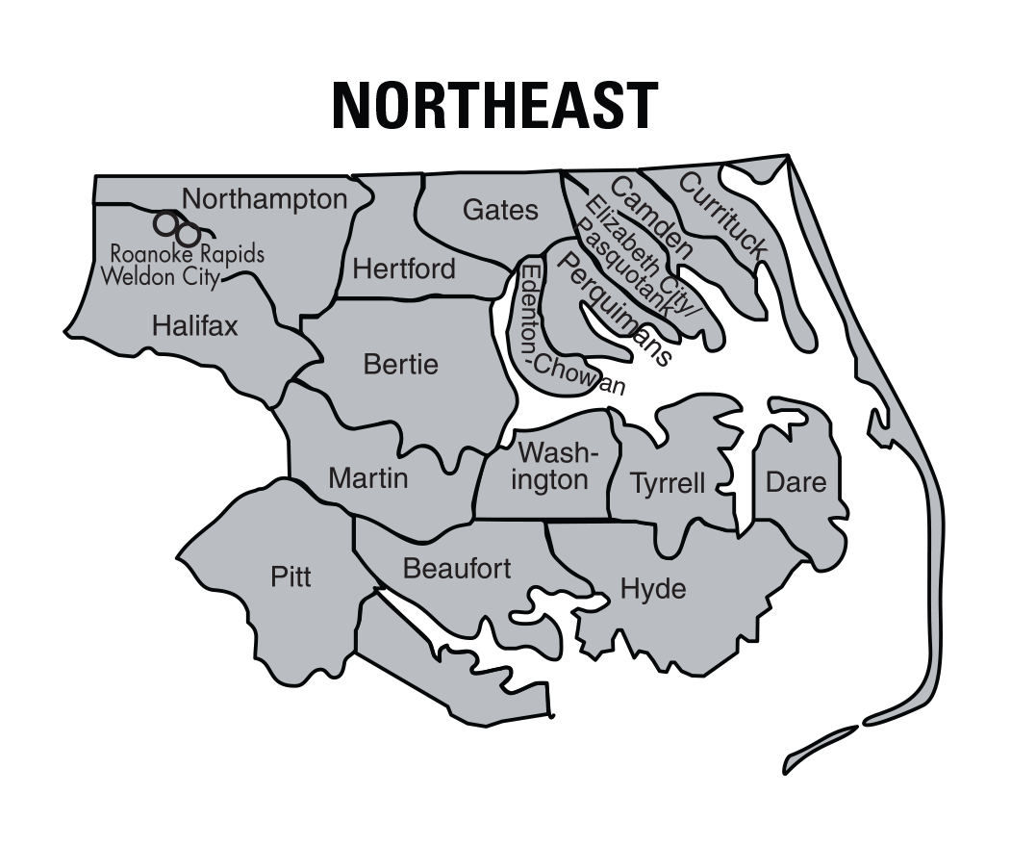
Beaufort
Bertie
Camden
Currituck
ECPS
ECPPS
Dare
Gates
Halifax
Hertford
Hyde
Martin
Northampton
Perquimans
Pitt
Roanoke Rapids
Tyrrell
Washington
Weldon City
Notes:
Jana

Slide 10
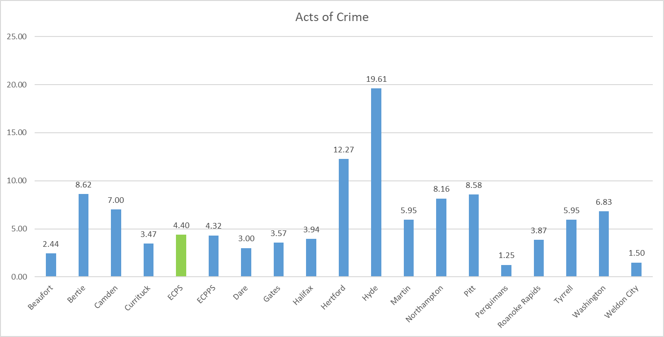
REPORTABLE ACTS OF CRIME– NE REGION
Rate per 1000 students
Notes:
Jana STANDARDIZED TO REFLECT PER 1000 STUDENTS district-wide

Slide 11
ECPS REPORTABLE OFFENSES 2021-2022
8 TOTAL | Possession of alcohol | Possession of Weapon | Assault on School Personnel | Possession of Controlled Substance
JAH | 2 | 4 | 1 | 1
Notes:
Jana ALL OTHERS ARE ZERO
REPORTABLE OFFENSES WITH ONLY ONE REPORTABLE ACT OF CRIME

Slide 12
SHORT-TERM SUSPENSIONS
STUDENTS WHO ARE SUSPENDED FOR TEN DAYS OR LESS
MAY INCLUDE MULTIPLE SUSPENSIONS FOR THE SAME STUDENT
STANDARDIZED AND CALCULATED PER 1000 STUDENTS
(TOTAL # OF EVENT OCCURRENCES / LEA POPULATION)*1000
AVERAGE SUSPENSION DURATION WAS 3.34 DAYS
Notes:
Jana-

Slide 13
SHORT TERM SUSPENSIONS 2021-2022 - ECPS
** TOTAL OF 353 | BLACK | HISPANIC | WHITE | TWO OR MORE RACES
FEMALE | 66 | 4 | 25 | 7
MALE | 172 | 6 | 57 | 16
Notes:
Jana LABELLED THE WAY IT IS USED IN THE REPORT

Slide 14
ECPS- Short Term Suspensions by school
 | # STS | STS DAYS | AVG DAYS PER STS | STS / 1000 STUDENTS
ECPS | 353 | 1,176.01 | 3.33 | 194.276
WOS | 38 | 62.81 | 1.65 | 93.827
DFW | 86 | 177.16 | 2.06 | 207.729
CMS | 146 | 533.65 | 3.66 | 342.723
JAH | 83 | 402.39 | 4.85 | 145.105
Notes:
Jana TABLE S4

Slide 15
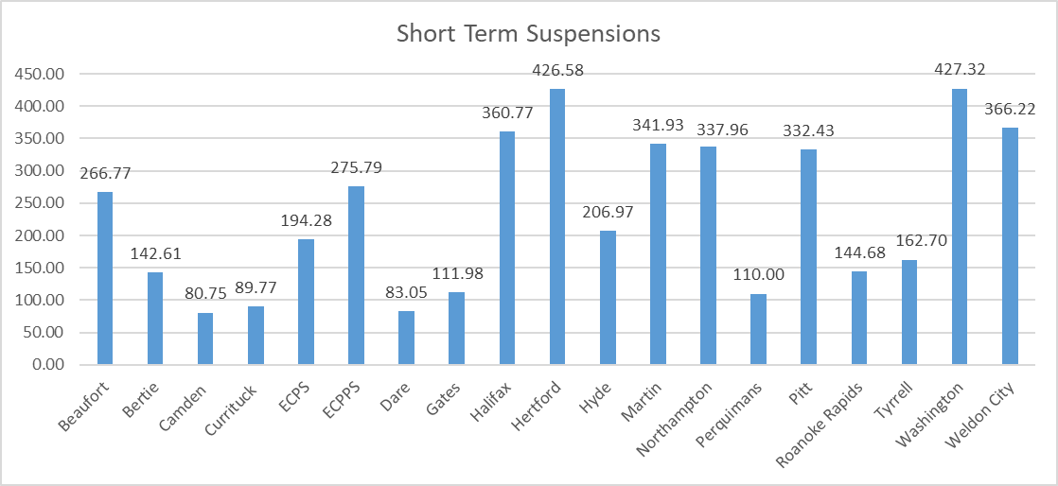
SHORT TERM SUSPENSIONS – NE REGION
Rate per 1000 students
Notes:
Jana

Slide 16
SHORT TERM SUSPENSIONS - PROXIMITY
 | TOTALS | BLACK | WHITE | HISPANIC | TWO OR MORE RACES | OTHER
BERTIE | 248 | 223 | 10 | 0 | 15 | -
ECPS | 353 | 238 | 82 | 10 | 23 | -
GATES | 157 | 46 | 99 | 2 | 10 | -
ECPPS | 1278 | 801 | 290 | 79 | 103 | 5
PERQUIMANS | 176 | 80 | 80 | 3 | 13 | -
Notes:
Jana TABLE S5

Slide 17
LONG TERM SUSPENSIONS/EXPULSIONS
GREATER THAN ELEVEN DAYS
MAY BE ASSIGNED TO ALP FOR TERM OF SUSPENSION
SOME OFFENSES REQUIRE 365 DAY SUSPENSION
SUPERINTENDENT MUST APPROVE LONG TERM SUSPENSIONS
STUDENTS CAN NEVER RETURN FROM AN EXPULSION UNLESS GRANTED BY BOE
Notes:
Jana

Slide 18
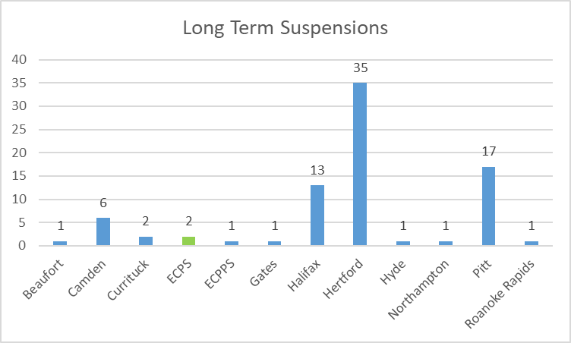
LONG TERM SUSPENSIONS – NE REGION
*** All other LEAs in the NE region reported 0 long term suspensions.
*** Expulsions:
Halifax 1
ECCPS 2
Washington 1
Notes:
Jana ECPS- 1 white male and 1 black male

Slide 19
DROPOUTS - GENERAL FINDINGS
GRADES 9-13: 10,841 UP FROM 9,512 IN 2018-19 (+14%)
60.4% OF DROPOUTS ARE MALES
ATTENDANCE ISSUES (46.7%) - MAIN REASON LISTED FOR DROPOUTS
Statewide: Hispanic males have the highest rate
Notes:
Va. Dropouts have increased across the state

Slide 20
AREA DROPOUT COUNTS
 | TOTAL | FEMALE | MALE | BLACK | HISPANIC | WHITE | TWO OR MORE RACES | ASIAN | Native Hawaiian/ Pacific Islander
ECPS | 11 | 3 | 8 | 4 | 1 | 4 | 2 | 0 | 0
PERQUIMANS | 9 | * | * | * | * | * | * | * | 0
GATES | 19 | 9 | 10 | 2 | 0 | 0 | 1 | 16 | 0
ECPPS | 68 | 36 | 32 | 28 | 6 | 30 | 3 | 0 | <10
BERTIE | 16 | 4 | 12 | 11 | 1 | 3 | 1 | 0 | 0
* Data set contains less than 10 students
Notes:
Va. TABLE D6

Slide 21
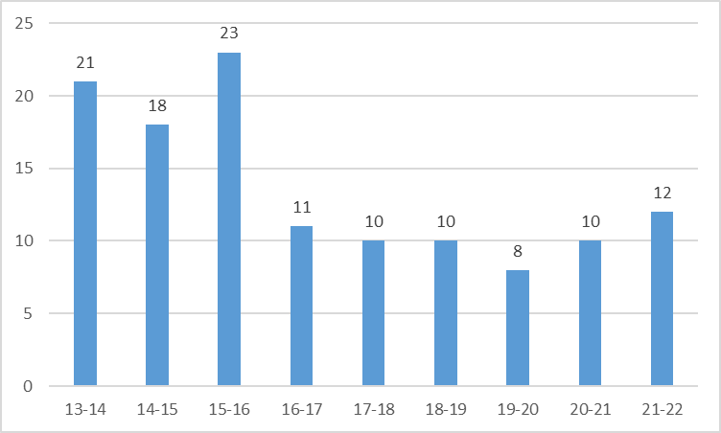
ECPS DROP OUTS
Notes:
Va.

Slide 22
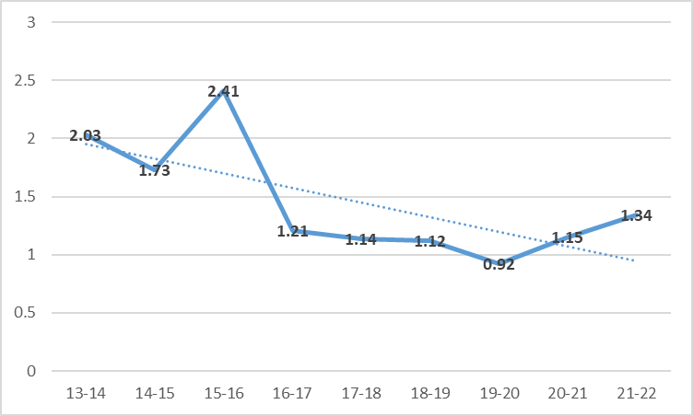
ECPS DROP OUT RATE
Notes:
Va.

