Slide 1
John A. Holmes
A Day in the Life of an ACE
Welcome to our transitional learning space as we construct the New JAHHS!

Slide 2
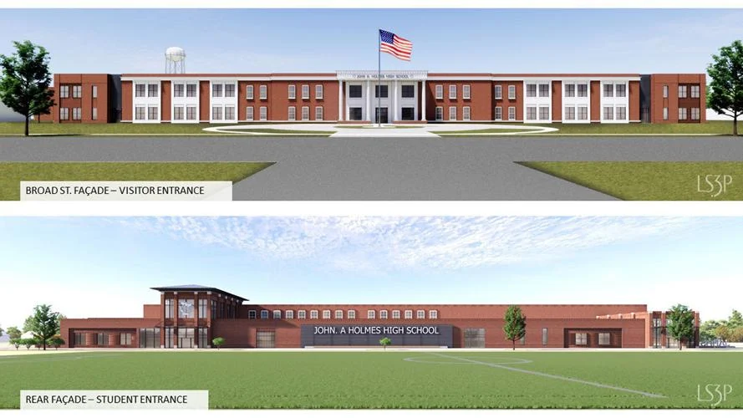
Notes:
Our vision and end goal- The transition phase to obtain this facility

Slide 3
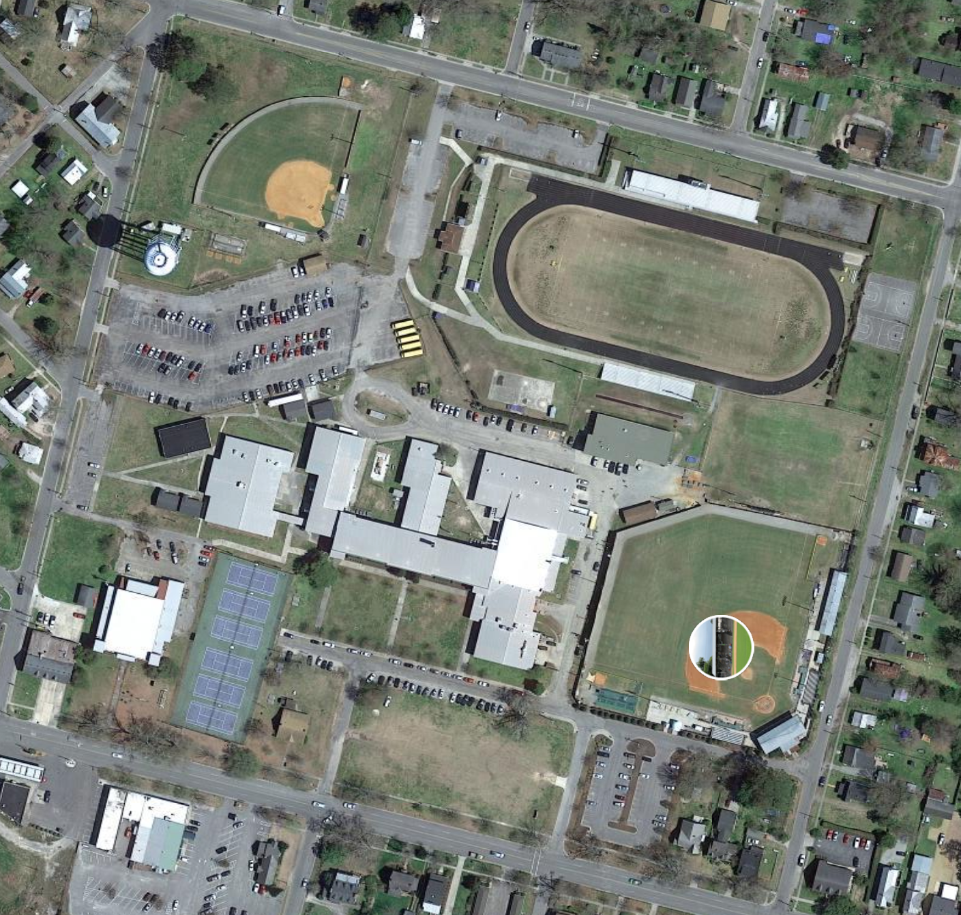

Slide 4
A Day In the Life of an ACE
Building Layout
Armory
ROTC, Band, Chorus and Theatre
CTE/EC Suite Wing/ Field House/ Gym
CTE electives, Life Skills and Health and PE courses
Ag Buildings- COA Campus
To be held at COA with Greenhouse usage
Notes:
Classes will beheld in the various locations.

Slide 5
A Day In the Life of an ACE
Building Layout
First Floor ACES Campus
OCS, Core Courses, and Guidance
Second Floor ACES Campus
Core Courses, Spanish, Visual Art and School Nurse
Recreational Gym
Lunch for students on this campus
Notes:
Basic layout
Talk about the learning space in this building -
All rooms will have monitors, white boards and a transitional space for learning

Slide 6
A Day In the Life of an ACE
Shuttle Service -Drop off- Student Drivers
Shuttle Service:
Bus at each location for shuttle service - 15 minute transition time built into the schedule
Drop Off:
Freemason Street to Woodard Street for Main Campus
Oakum Street for ACES Campus
Student Drivers:
The student parking lot will be available for student drivers

Slide 7
A Day In the Life of an ACE
7:40 am Buses Unload
7:40 am - 7:55 am Grab & Go Breakfast at ACES Campus and JAH Main Campus cafeteria
8:00 am - 9:29 am 1st Block
9:29 am - 9:44 am Transition/Remediation 15 mins.
9:44 am - 11:13 am 2nd Block
11:13 am - 11:28 am Transition/Remediation 15 mins.
11:28 am - 1:22 pm 3rd Block
11:28 am - 11:55 am Lunch 1 A/B
12:57 pm - 1:22 pm Lunch 2 C/D
** A & C will eat at ACES Campus
** B & D will eat at JAH Main Campus
1:22pm - 1:37pm Transition/Remediation 15 mins.
1:37pm - 3:06pm 4th Block
Notes:
Daily life - Bell schedule. Matches this year. We will plan to have 15 minutes in between classes for shuttle service.
2 lunches on each campus
Dismissal at 3:06 - aligns with our extracurriculars so students do not miss 4th block for travel or experience.

Slide 8
A Day In the Life of an ACE
JAH Doors open at 7:40 am on all campuses
Car Riders: Drop off via Oakum Street or Freemason / Woodard based on first period class
All students will be routed through a metal detectors prior to entering first block
Grab and Go Breakfast at ACES Campus and JAH Main Campus Cafeteria
Bus riders will get off at first block location.

Slide 9
A Day In the Life of an ACE
Tardy/ late Students Check In for note to enter rooms:
ACES Campus: Check in the front door
JAH Main Campus: Check in the Commons/ Gym office
Notes will allow entrance into class

Slide 10
A Day In the Life of an ACE
Shuttles will rotate through each class period.
All students are expected to ride the shuttle buses.
Students changing campus locations will be allowed to leave upon the bell. All others will stay until the last 5 minutes of the transitional time.

Slide 11
A Day In the Life of an ACE
Lunch:
Two service times on JAH Main Campus and two on ACES Campus-
Beginning and end of third block
Hot and Cold Options for student choice

Slide 12
A Day In the Life of an ACE
4th block: No courses held downstairs at ACES Campus to clean and prepare for the Boys and Girls Club
Dismissal:
Bus riders will be picked up at each location
An activity bus will shuttle students to each location for extracurricular activities

Slide 13
A Day In the Life of an ACE
Location of Office Staff
Central Services Building - 800 North Oakum Street
Records; Transcripts; Enrollment; and Bookkeeping
Parents will go there to the ACES Campus front door:
Sign in / sign out students

