Slide 1
FEDERAL PROGRAMS
ECPS BOARD OF EDUCATION MEETING
AUGUST 15, 2023
PRESENTED BY: M. VICKERS & J. RAWLS
Notes:
Jana

Slide 2
FUNDING - VARIOUS GRANTS
Title I, Part A (Improving the Academic Achievement of the Disadvantaged) – PRC 050
Title II, Part A (Preparing, Training, and Recruiting High Quality Teachers, Principals, and Other School Leaders) – PRC 103
Title III Part A (English Language Learners) - PRC 104
Title IV, Part A, Subpart 1 (Student Support and Academic Enrichment) – PRC 108
Title VI - (IDEA PreSchool) - PRC 049
Title VI B- (IDEA Handicap) - PRC 060
Title V Rural Low-Income Schools (RLIS) – PRC 109
IDEA Early Intervening Services - PRC 070
Career and Technical Education Program Improvement - PRC 017
Elementary and Secondary Schools Emergency Relief - PRCs 171,181
Notes:
Mindy

Slide 3
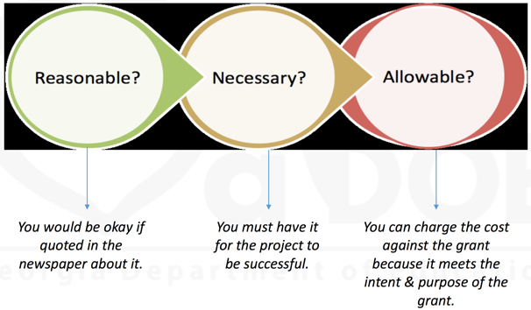
3 PRONG TEST
Notes:
Mindy

Slide 4
Title I - Improving Academic Achievement of the Disadvantaged
Provide equitable opportunities for low achieving students in schools with high concentrations of income families
Close Educational Achievement Gaps
Poverty percentages based on 22-23
WOS - 72.9%
DFW - 79.8
CMS - 80.5%
JAH - 71.8
We will serve Elementary and Middle Schools only
Includes McKinney-Vento Set Aside for homeless students
Notes:
Mindy
Funding must be used to supplement, not supplant

Slide 5
We do the following with Title I Funding:
Teachers, IAs, Academic Coaches and salary benefits to reduce class sizes or provide services to improve student performance
- Supplies and materials
- Assessment programs and screeners
- Tutoring
- Parent and Family Engagement items and programs
- Professional Development
- Other items that are appropriate and part of the overall school improvement process
Notes:
Mindy
Funding must be used to supplement, not supplant

Slide 6
Title II-
Preparing, Retaining and Recruiting High Quality Teachers, Principals, and Other School Leaders
Designed to provide for greater access to effective educators
Improvement of classroom instruction
Improvement of student learning and achievement
Retention of effective teachers, principals and other school leaders
WE USE TO:
Support testing & licensure requirements
Pay for mentors and professional development of novice or beginning teachers
Support for added credentials, including AIG certification
Support acquisition of international faculty
Notes:
Jana

Slide 7
Title III - English Language Learners
The purpose of Title III is to help ensure that English learners (ELs) attain English language proficiency and meet state academic standards. Federal funding is provided through various grant programs to assist state education agencies (SEAs) and local education agencies (LEAs) in accomplishing this.
We are part of a consortium that includes 11 other school districts in our area.
Budget to Edenton-Chowan averages $10,000
WE USE FOR:
Workshop Expenses
Parent Workshop Expenses
Contracted Tutoring
Supplies and Materials
Notes:
Mindy

Slide 8
Title IV - Student Support and Enrichment
Provide all students with access to a well- rounded education
Improve school conditions for learning
Improve use of technology in order to improve academic achievement and digital literacy of all students
WE USE FOR:
Curriculum resources and supplies
Social emotional learning
Formative testing support
Professional development
Support for the HS if needed since they are not Title I
Notes:
Mindy

Slide 9
Title VI - IDEA Preschool; IDEA Handicap
Support for special education and related services
Additional academic and behavioral support for students
Improve use of technology in the classroom
WE USE TO:
Pay portion of EC Pre-K Teacher Salary (IDEA Preschool)
Pay 8 EC Teacher Assistant salaries and benefits (IDEA Handicap)
Notes:
Mindy

Slide 10
Title V - Rural and Low Income Students
Used for initiatives to improve student achievement
Have traditionally supported CMS and JAH but can be used for all schools
WE USE TO:
Support tutoring and summer school programs for students
Provide school level teacher coaching support and professional development
Instructional initiatives to support student learning
Notes:
Jana

Slide 11
Career and Technical Education Program Improvement
Federal funds that provide support to improve the academic and career and technical skills of students in grades 6-12
Career awareness activities are also supported for students beginning in grade 5
For the development, coordination, implementation or improvement of CTE Programs
WE USE FOR:
-Classroom supplies and equipment improvement
-Field Trip Expenses
-Career and Technical Student Organization support
Notes:
Jana

Slide 12
ESSER II, III
Pandemic relief funding to support continuity of education and safe learning environments
WE USE FOR:
Additional SEL support staff (counselors, social worker, behavioral specialists, contracted services) and professional development
Additional academic support (interventionists, instructional coach, PreK, academic resources, Advanced Teaching Roles)
Curriculum planning (Maps, SAP’s)
Summer Programming
Renovations, HVAC improvements
Notes:
Mindy

Slide 13
FUND | FY 2024 | FY 2023
TITLE I | $741,488 | $725, 024
TITLE II | $106,391 | $107,114
TITLE III | About 10,000
TITLE IV | $57,732 | $48 ,091
TITLE VI (Pre School) | $24,988 | $24,431
TITLE VI-B (Handicap) | $470,983 | $437,644
RLIS | $39,983 | $49,692
CTE | $41,609 | $40,547
ESSER II/III (Carry over) | $2,771,105 | $5,154,355
TOTAL FY ‘24 FUNDING
$1,493,174
With carry over
$4,749,324
FY ‘23
6,650,983
Notes:
Mindy

